Slide 1

Gradient Boosting
-- Mounika Voriganti

Slide 2
Ensemble technique
Ensemble methods are techniques that create multiple models and then combine them to produce improved results.
In ensemble learning, many base models like classifiers and regressors are generated and combined together so that they give better results.

Slide 3
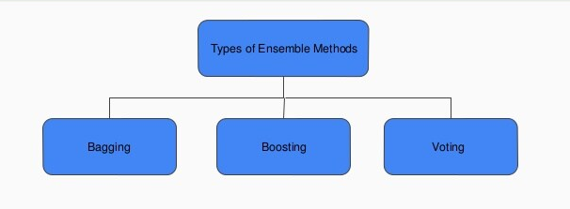
Types of Techniques:

Slide 4
Gradient Boosting
Gradient boosting is one of the most powerful techniques for building predictive models
Gradient boosting is a machine learning technique for regression and classification problems that produce a prediction model in the form of an ensemble of weak prediction models.
Gradient boosting basically combines weak learners into a single strong learner in an iterative fashion.

Slide 5
How Gradient Boosting Works
Gradient boosting involves three elements:
A loss function to be optimized.
A weak learner to make predictions.
An additive model to add weak learners to minimize the loss function.

Slide 6
Steps
Height(m) | Favourite Color | Gender | Weight(kg)
1.6 | Blue | Male | 88
1.6 | Green | Female | 76
1.5 | Blue | Female | 56
1.8 | Red | Male | 73
Calculate the average/mean of the target variable.
Height(m) | Favourite Color | Gender | Weight(kg) | Prediction 1
1.6 | Blue | Male | 88 | 73.5
1.6 | Green | Female | 76 | 73.5
1.5 | Blue | Female | 56 | 73.5
1.8 | Red | Male | 73 | 73.5

Slide 7
calculate the residuals for each sample.
Residual = Actual Value - Predicted Value
use decision tree algorithm to train the model considering residual as label . We build a tree with the goal of predicting the Residuals.
Repeat steps 3 to 5 until the number of iterations matches the number specified by the hyper parameter(numbers of estimators)
Height(m) | Favourite Color | Gender | Weight(kg) | Prediction 1 | Residuals(1)(New target variable)
1.6 | Blue | Male | 88 | 73.5 | 14.5
1.6 | Green | Female | 76 | 73.5 | 2.5
1.5 | Blue | Female | 56 | 73.5 | -17.5
1.8 | Red | Male | 73 | 73.5 | -0.5

Slide 8
Height(m) | Favourite Color | Gender | Weight(kg) | Residuals(2)(New target variable)
1.6 | Blue | Male | 88 | 13.05
1.6 | Green | Female | 76 | 2.25
1.5 | Blue | Female | 56 | -15.75
1.8 | Red | Male | 73 | -0.45
New residual value for first sample =(88-73.5+0.1(14.5))=13.05
Once trained, use all of the trees in the ensemble to make a final prediction as to value of the target variable. The final prediction will be equal to the mean we computed in Step 1 plus all the residuals predicted by the trees that make up the forest multiplied by the learning rate.

Slide 9
Formula:
final prediction = Average Price +
LR*Residual predicted by DT1 +
LR*Residual Predicted by DT2 + .......
LR*Residual Predicted by DT N
Here,
LR = Learning rate
DT = Decision tree

Slide 10
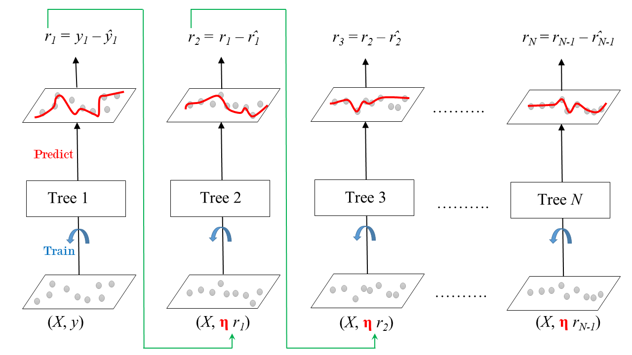

Slide 11
Thank you

